Slide 1
TAB MANAGER Tile manager
Purna Akshaya S R

Slide 2
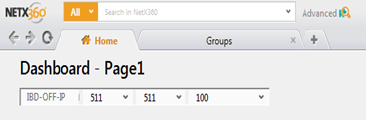
TAB MANAGER Purpose/ Functionality
A tabbed document interface (TDI) is a graphical control element that allows multiple documents or panels to be contained within a single window, using tabs as a navigational widget for switching between set of documents.

Slide 3
Features
New tab
Detach
Copy to new tab
Copy to new window
Tab switch
Static tab

Slide 4
Features
Reordering tabs
Recently viewed
Check for override
Dispose controls
Remember tabs
History manager

Slide 5
Tab control
TabControl manages tab pages where each page may host different child controls.
TabControl is just a container and has no value without tab pages.
Tab item
Each tab item contains screen view name and tab data.
Tab data
App data
Application specific
Framework data
Information about current tab

Slide 6
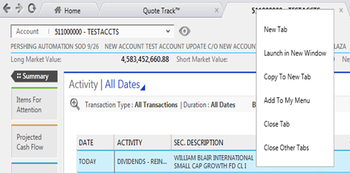
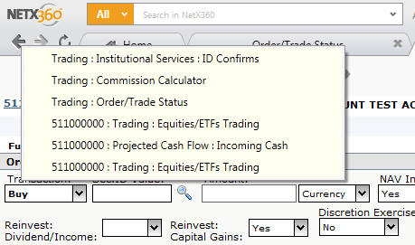

Slide 7
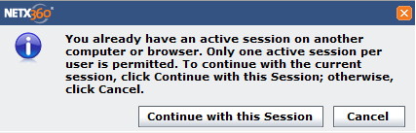
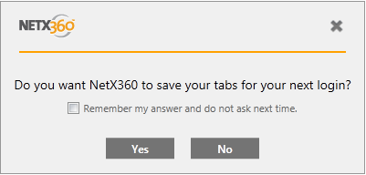

Slide 8
GUID
A Globally Unique Identifier is a 128-bit integer (16 bytes) that can be used across all computers and networks wherever a unique identifier is required. Such an identifier has a very low probability of being duplicated.
GUIDs are usually stored as 128-bit values, and are commonly displayed as 32 hexadecimal digits with groups separated by hyphens.
Every time a new tab is created, a new GUID is generated.
Maintained in each tab’s tab data.

Slide 9
Hierarchy
Layout Manager
Layout style=‘Card’
Card Layout Manager
CreateTab
ActivateTab
Aqua Tab Manager

Slide 10
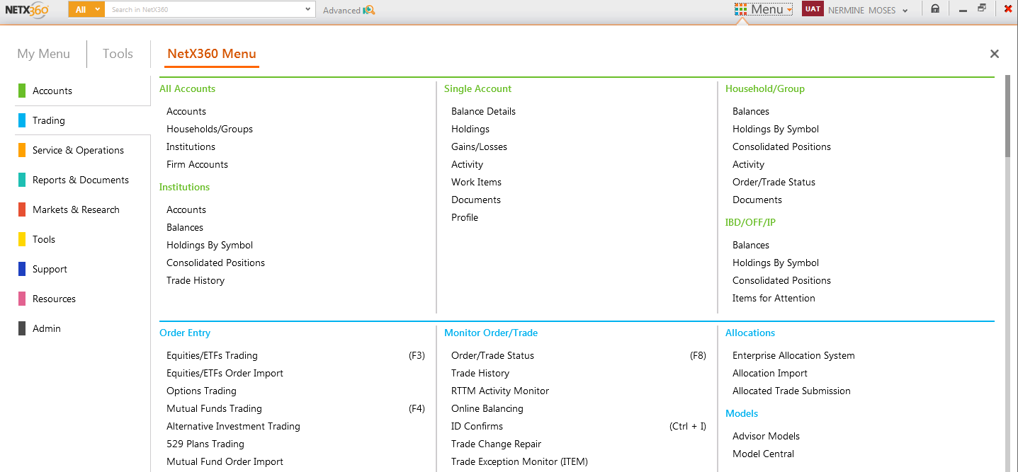

Slide 11
Opening modes
Same view
New view
Detach
Revisit
Modal
Modaless
Tabmodal

Slide 12
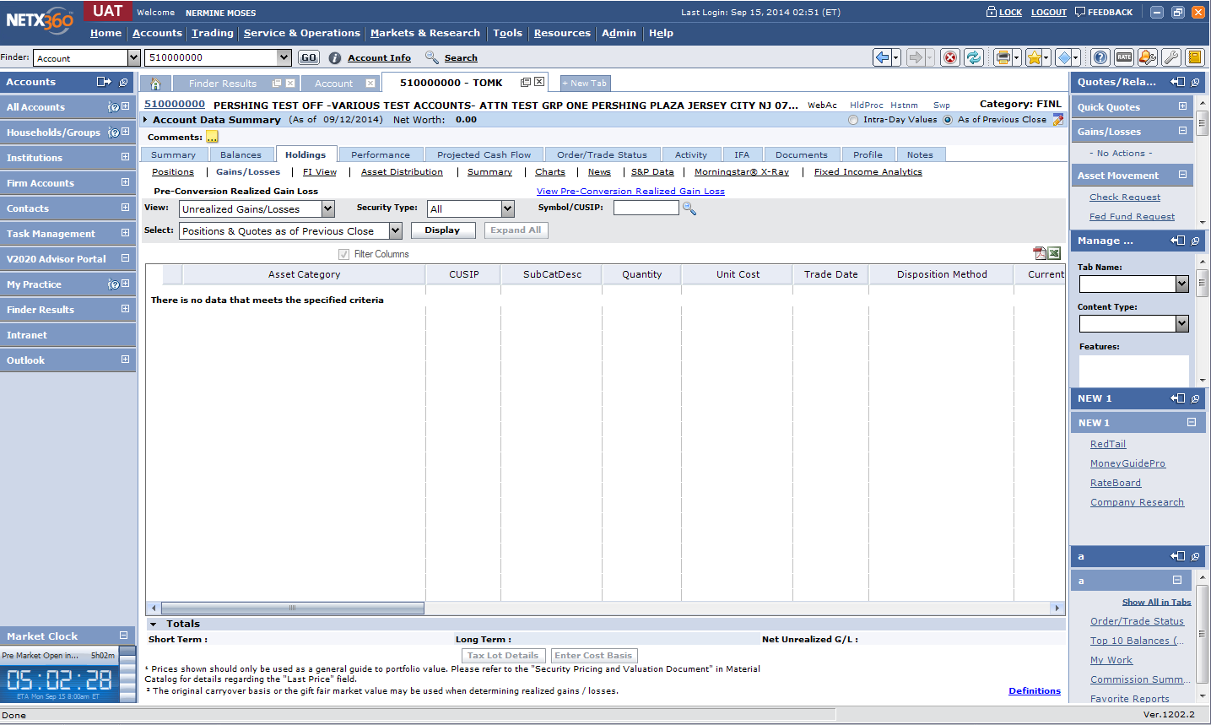
Liberty View

Slide 13
Levels of navigational tab in Liberty
1st level tab
Level 1: Navigational tab
2nd level tab
Level 2 : Non- Navigational tab
3rd level tab
Level 3 : Non- Navigational tab

Slide 14
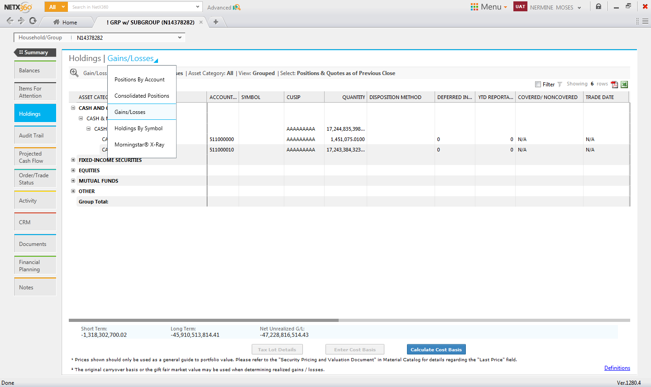
Aqua View

Slide 15
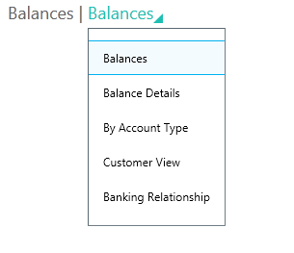
Levels of navigational tab in Aqua
1st level tab
(card)
Pre tab
Post tab
2nd level tab
(tile)
3rd level tab
(dropdown)

Slide 16
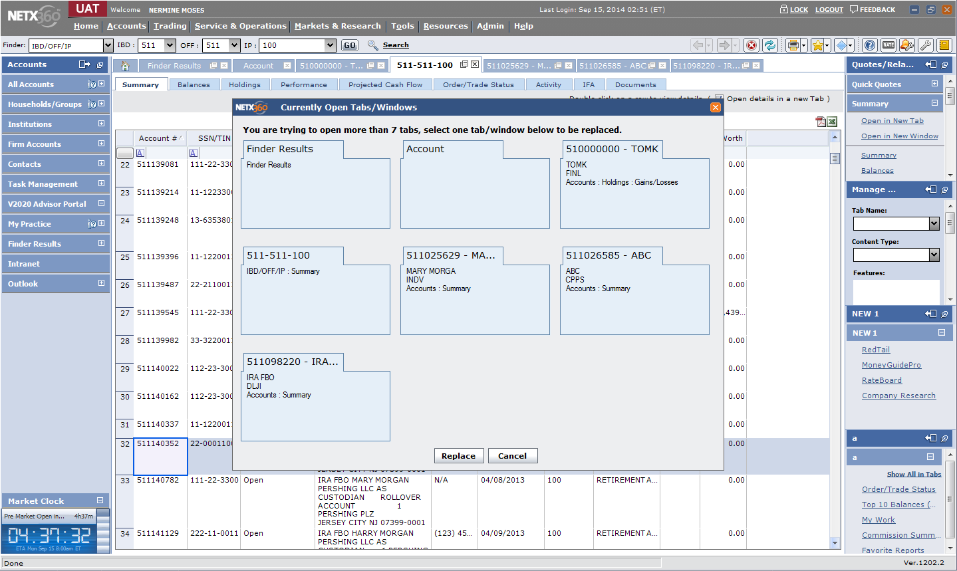

Slide 17
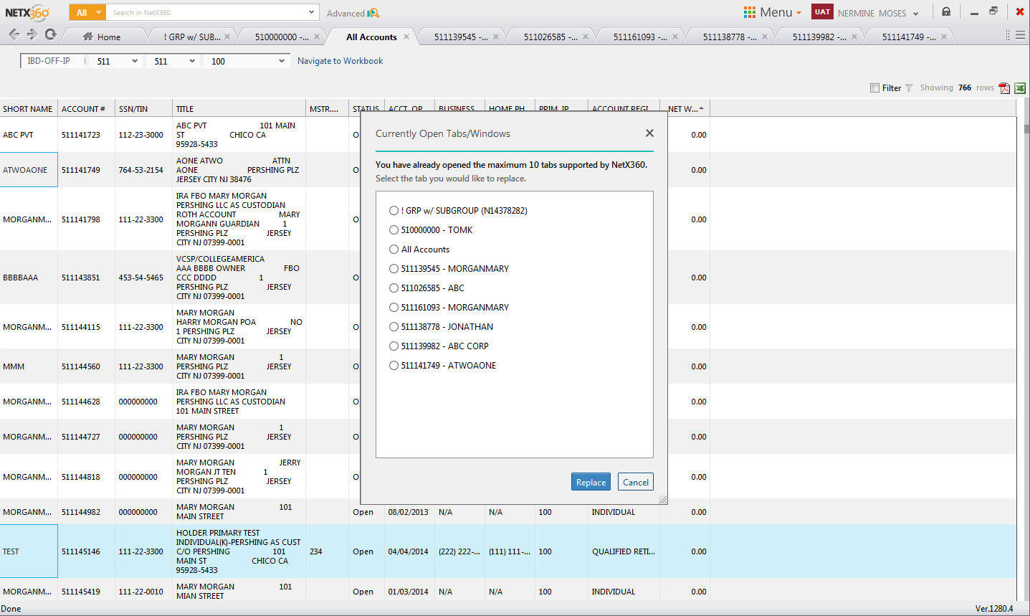

Slide 18
TILE MANAGER Features
Normal mode
Min mode
Max mode
Split mode
Add content

Slide 19
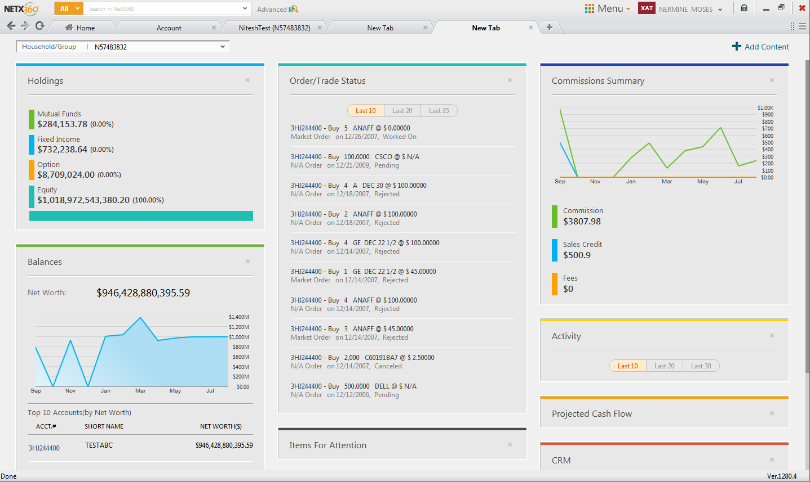
Normal mode
Can be customized

Slide 20
Min mode Max mode
Drag & drop
Reposition
Original content
Can be converted to split mode

Slide 21
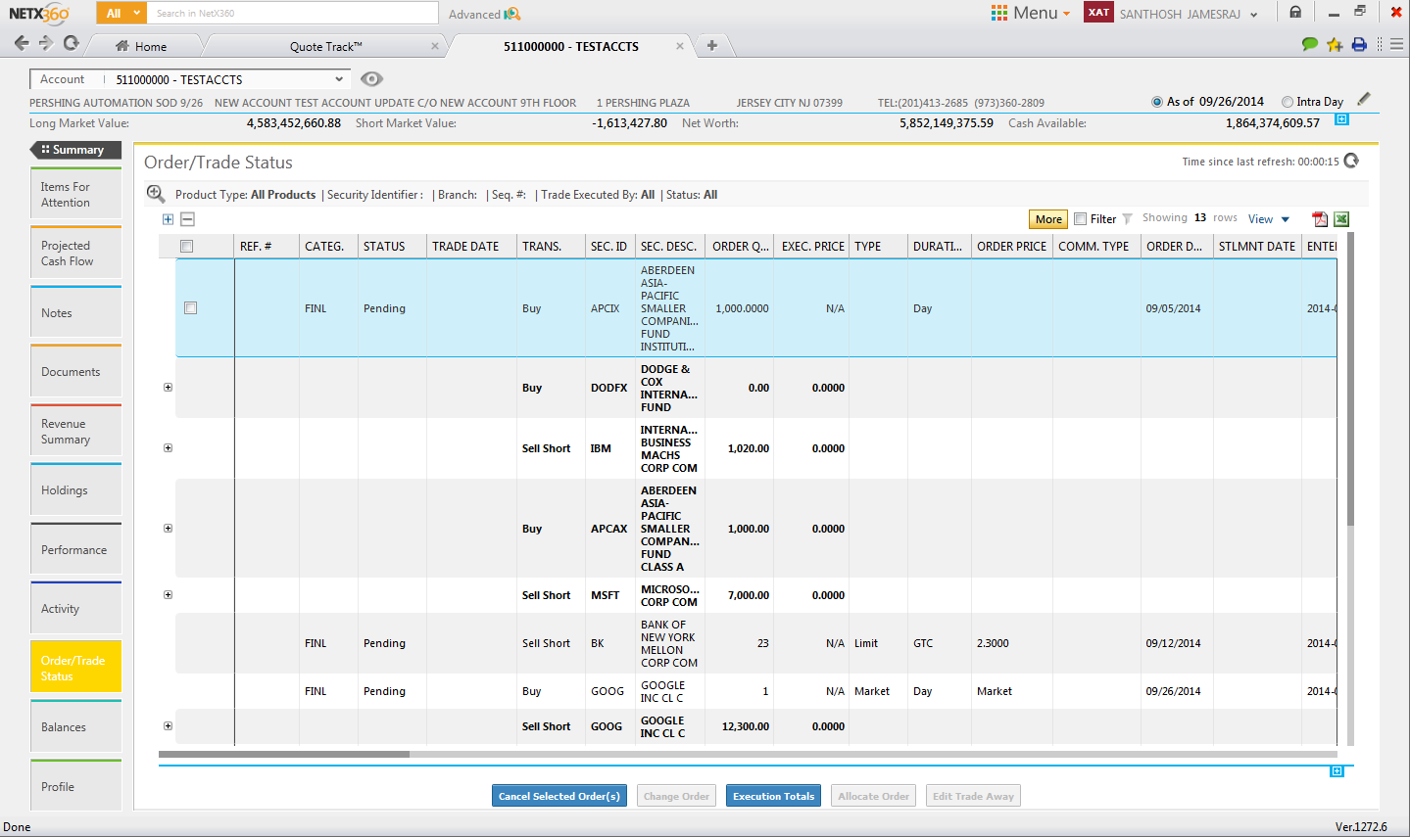
Min mode
Max mode

Slide 22
Split mode
Drag & drop
At one instant of time, two max views can be created.
At runtime, new screenview with two max mode screenviews are created.

Slide 23
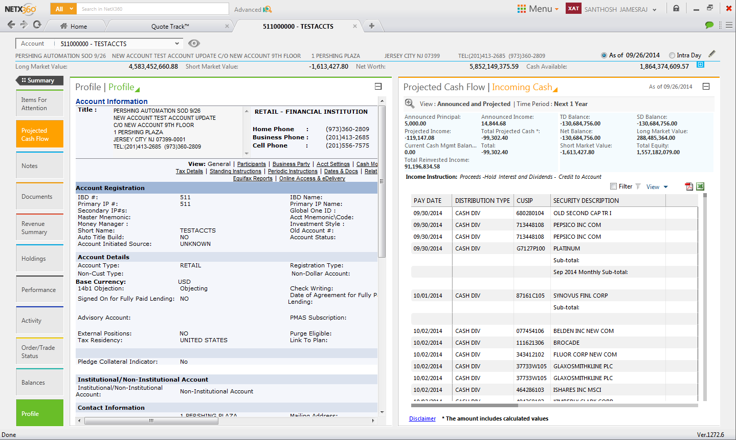

Slide 24
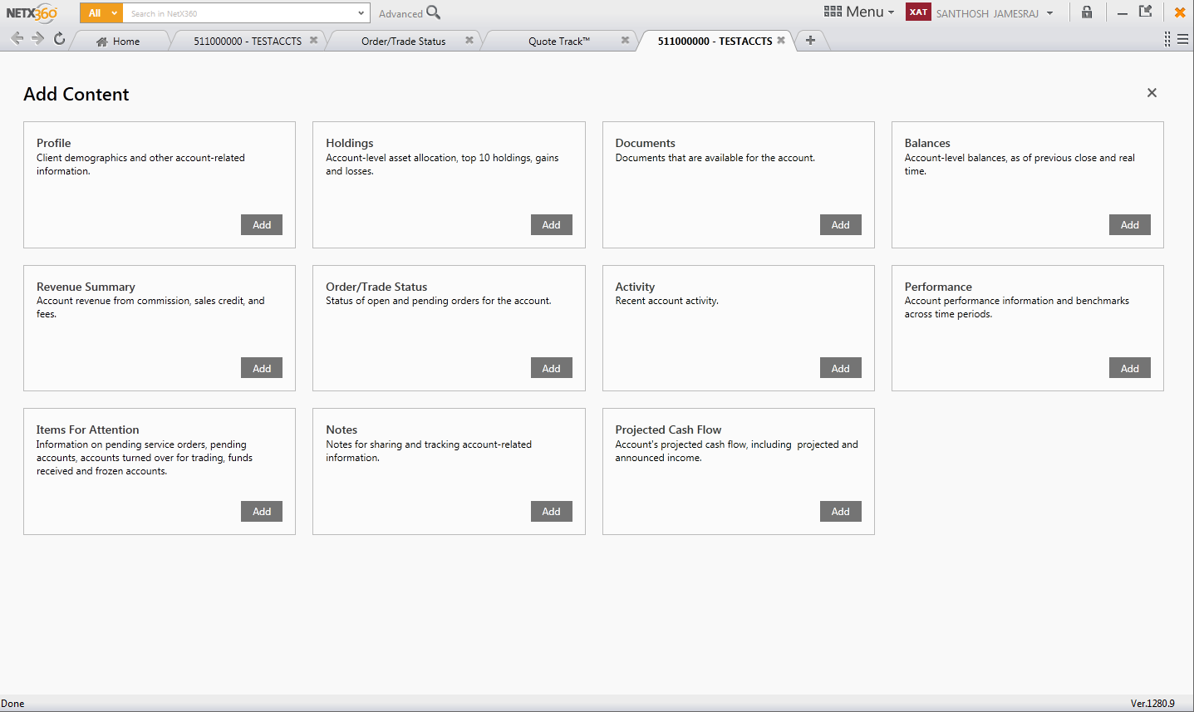

Slide 25
Settings
Normal mode:
During close, visibility is set to false.
Positions can be changed dynamically, according to user specifications.
Min mode:
Positions change according to the changes made in max views.
Displayed from L->R, T->B.

Slide 26
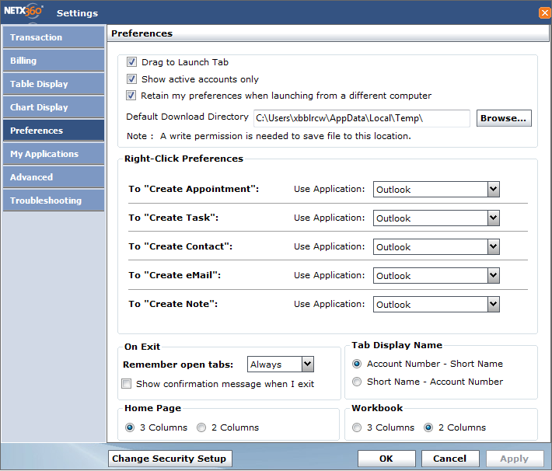
Customized column count

Slide 27
Thank You

